Slide 1


Master in Innovation and Research in Informatics (MIRI)
Data Mining and Business Intelligence track.
Multivariate Analysis course
Big Data and L_{p}–norm estimators
in multiple regression models affected by multicollinearity
Prof. Massimiliano Giacalone
massimiliano.giacalone@unina.it

Slide 2
Key words:
multicollinearity,
exponential power function,
Lp norm estimators,
Kurtosis indexes.

Slide 3
1. Introduction “For non-normal distributions of the εi’s the least-squares estimates have minimum variance among unbiased estimates that are linear combinations of the Yi’s” (Cox and Hinkley, 1968).
And in case of multicollinearity?
In this paper we consider the possibility of creating some adaptive robust estimation procedures for the standard linear regression model when the disturbance vector has deviated from normality.

Slide 4
We propose some simulation plans in order to compare the Lp-norm estimators with the least squares method in the case of multicollinearity, a regression problem introduced in the second section of the paper.
After a brief review on the origins of the Exponential Power Function (E.P.F.), a useful family of symmetrical random error curves, we show their connection with the Lp-norm methods in the third section

Slide 5
In the fourth section we investigate the relationships between the different values of p, the shape parameter of the E.P.F., and some kurtosis indexes that refer to the error distributions; then we analize and propose the Lp-min algorithm

Slide 6
In the subsequent sections we compare three estimation procedures by introducing a linear regression model with collinear regressors.
The aim of the simulation study is to choose the best rule for selecting the most appropriate value of p for any given error distribution and to evaluate the influence of multicollinearity in the parameter estimation procedures in terms of bias and variance.
Finally, in the last paragraph, some results and comparations are discussed

Slide 7
2. Multicollinearity in regression
A regression model has two main purposes:
it could be used to find out to what extent the outcome (dependent variable) can be predicted by the independent variables and
it could be used to determine the strength of a theoretical relationship between the dependent variable and the independent variables.
A regression problem can be affected by multi-collinearity. The absence of multicollinearity is essential to obtain optimal estimates by a multiple regression model. The strength of the prediction is indicated by R², also known as variance explained or strength of determination.

Slide 8
In regression, the multi-collinearity or collinearity problem occurs when several regressors are highly correlated. When things are related, we say they are linearly dependent on each other because one can nicely fit a straight regression line to pass through many of the data points of those variables.
Collinearity simply means co-dependence. It should be eliminated. Doing it is problematic when one’s purpose is explanation rather than mere prediction. Indeed, when prediction is the goal, no problem arises if, among dependent variables, two regressors have the same ‘meaning’: simply, it is possible to eliminate one of them.
When, instead, explanation is the goal, regressors are selected according to a theoretical rule, so that it is not possible to eliminate any variable; the model has to be explained exactly, including every variable which was selected.

Slide 9
Therefore the multi-collinearity problem can and must be eliminated in the case of prediction while is often uneliminable in the case of explanation. In this latter case, eliminating a variable leads to a problem of bad-specification of the model.
A viable remedy for bad-specification is to prefer a different estimator than the least squares one. This is because the ‘classical’ OLS method provides estimates which could be statistically not significant in presence of multi-collinearity.
It would be better to use alternative methods such as the Ridge Regression (Morris, 1982; Pagel and Lunneberg, 1985) or the Partial Least Squares (Cassel et al., 1999). Variance inflation is the consequence of multi-collinearity. We might say multi-collinearity is the symptom whereas variance inflation is the disease.

Slide 10
In a regression model we expect a high variance explained (R-square).
The higher the variance explained, the better the model.
However, if collinearity exists, probably the variance, standard error and parameter estimates are all inflated.
Here we are going to carry out some simulation studies in order to show some evident differences among three estimation metho ds (Least Squares estimators and two different Lp-norm estimators) in presence of multi-collinearity.

Slide 11

3. The Exponential Power Function and the L p norm estimators
The E.P.F is a family of probability functions proposed by Subbotin in 1923 and studied by Vianelli (1963), Lunetta (1963), Mineo A (1989). The density function is:
where Mp = E(z) is the location parameter, σp = (E [|z − Mp|]) 1/p is the scale parameter, and p > 0 is the shape parameter.

Slide 12
Considering the Pearson kurtosis index β2 we distinguish:
• 0 < p < 1: double exponential distributions, β2 > 6; • 1 < p < 2: leptokurtic distributions, 3 < β2 < 6; • p > 2: platikurtic distributions, 1.8 < β2 < 3; For particular values of p we have: the Laplace distribution (p = 1, β2 = 6);
the Gaussian distribution, (p = 2, β2 = 3); and the Uniform distribution (p → ∞, β2 → 1.8).

Slide 13
Let us consider a sample of n observed data (yi, xi), a general linear regression model is:

Slide 14

The Lp-norm estimators are a mere generalization of the Least Squares replacing exponent 2 by a general exponent p.
Therefore they minimize the sum of the p-th power of the absolute deviations of the observed points from the regression function:

Slide 15
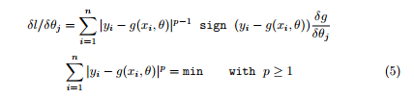
Under the regularity assumptions the log-likelihood related to the sample is given by:
where we consider z = yi and µp = g(xi, θ)

Slide 16
The optimal exponent p for the Lp-norm estimators of the regression parameters is the shape parameter p of the E.P.F.
If it is unknown, we have two related problems to consider:
1. the estimation of the exponent p on the sample data; 2. the choice of the minimization algorithm to obtain the regression parameters estimation.
When analysing real data, though, a fundamental problem is to obtain a good estimation of the p parameter. To estimate it, it is possible to use different methods:

Slide 17
1st method
Harter (1977), noting that p depends on ˆβ² (the sample residual Kurtosis), proposed to select p with the following rule:
if ˆβ² > 3.8 use p = 1 (the least absolute deviations regression). if 2.2 < ˆβ² < 3.8 use p = 2 (the least squares regression). if ˆβ² < 2.2 use p = ∞ ( the minimax o Chebychev regression).

Slide 18

2nd method
Money et al. (1982) and Sposito et al. (1983) proposed two different criteria respectively:

Slide 19
3rd method
Mineo A. (1989) proposed the Generalized Kurtosis βK, as described in the following section.
Mineo A.M. (1994) considered a new method to estimate p, based on an empirical index called VI.
This estimation method is based on a two-steps algorithm in which, iteratively, pˆ and the other parameters’ estimates are evaluated: the structure parameter is estimated by numerically solving an equation in which the theoretical value of the I index is equaled to the empirical one; the other parameters are estimated from the corresponding maximum likelihood estimators as a function of the current value of pˆ.
This procedure is iterated until convergence. It is a method that needs some adjustments when ˆp has either a very high value or is less than one.

Slide 20
4th method
Agro’ (1995) proposed a maximum likelihood estimation either for the regression parameters or for the p shape parameter.
It is a two-steps process which, however, is essentially suitable for medium to large samples (n > 50); later, Agro’ (1999) proposed an adjustment of the likelihood estimation, based on Cox e Reid (1987), which consists of a reparametrization that leads to asymptotically uncorrelated estimators and, consequently, to better results (at least, for n > 30)

Slide 21

4. The Exp onential Power Function kurtosis indexes
For the density (1), the theoretical moment of order k is a function of the shape parameter p as follows:

Slide 22


The ratios of the moments of order 2k and the squared moment of order k only depend on the shape parameter p. This theoretic relation is also called ” Generalized Kurtosis” (Mineo, 1989) :
if k = 2 we can write the Pearson Kurtosis index:

Slide 23

If k = 1 considering the square root of the reciprocal we get the Geary length of tails index:

Slide 24

The indexes I and β2 show a different behaviour according to the variation of p (Giacalone, 1997).
Calculating the sample values of I and β2 , it is possible to obtain, by inverse interpolation, two different estimations of p.
Gonin and Money (1987), Lunetta, (1966), Kendall-Stuart, (1966) considered the unbiased estimates of the second and fourth order sample moments with correction factors depending on the sample size n :

Slide 25


The ratio of ˆµ⁴ and ˆµ² gives the following estimator of β²:
For the I empirical index we obtain:

Slide 26
5. The Lp min algorithm
It is based on a two-steps alternating procedure :
a) minimization procedure to estimate the parameters,
b) joint inverse function of I and β² to estimate p .
The algorithm is stopped when p does not vary significantly. The function used to estimate p is therefore the following :

Slide 27

where I , Iˆ, β₂, ˆβ₂ are respectively given by (10), (12), (9), (11).
For simplicity we express the (13) as [f(p)] 2 +[g(p)] 2 = min to take into account the different variability and average order size related to p , and the standardization factors are the maximum theoretical values.

Slide 28
So using the relation (9) we calculate max(β2) = 25.2 for
p = 0.5 , lower bound in our simulation plan, whilst using the relation (10) we calculate max(I) = 0, 86054, for p = 10 upper bound in our simulation plan.
The proposed algorithm (Giacalone, 1997) is then specified in the following steps:
STEP 0: Set i = 0 and p 0 = 2 ;
STEP 1: Fit the model to the data using the previous step value pi;

Slide 29
STEP 2: Compute the estimated residuals εi = yi− g(xi, θ), their average ε¯ and insert these quantities in the (13) which is equal to the sum of the two squared functions to be minimized;
STEP 3: Minimize the function (13) to obtain pi +1 , new estimate of p;
STEP 4: Compare the estimated pi +1 with the previous pi , and if | pi +1 − pi| > 0.01 then set i = i + 1 and repeat steps 1-4, otherwise:
STEP 5: Stop the algorithm assuming the values θˆi = θij as Lp-norm estimators for the parameters θi and the value p = pi .as joint estimation of p.

Slide 30
In step 1 a nonlinear Lp-norm estimation is considered (Fletcher and Reeves, 1964).
In step 3 a parabolic interpolation method (Everitt, 1987) to find the minimum of the sum of squared functions (13) is adopted.

Slide 31

6. The simulation plan
We consider 500 samples of sizes n = 50, 100, generated from E.P.F., and 6 values of p, ranging from 1.0 to 3.5 with step 0.5.
The algorithm for generating the εi (for p ≥ 1 ) from an E.P.F. is suggested by Chiodi (1986).
The values of yi are given by the multiple regression model:

Slide 32


with X1, X2 identically distributed and independent variables from a Gaussian standardized distribution and X3 a linear combination of X1 and X2.
Therefore we can write the related variance and covariance matrix: It is easy to

Slide 33

see that: E(X32) = E(X12) + E(X22) + σ z² = 2 + σ z² and the correspondent correlation matrix is equal to:
where r13 = cov(X1 , X3)/pvar(X1)var(X3) = 1/p1(2 + σ z²) = r23 and R²3 .12 = 1 − detA/detA33 = 2/(2 + σ z²)

Slide 34
In the simulation model one can see that the rate of multicollinearity is (inversely) proportional to σ z².
Let be the parameter values β0 = 1, β1 = 2, β2 = 3, β3 = 4, a comparative analysis is made applying the following three estimation methods on the same samples, with the results reported in the tabb 2-7 :
1. Least squares estimators (L2). 2. Lp-norm estimators with theoretical p of the E.P.F. (Lp). 3. Lp-norm estimators with p as in our proposal ( 5) (Lp min ).

Slide 35
One can see that for any p and for any method, the parameter estimates of β0, β1, β2 , β3, are biased when n = 50 but their variances decrease for increasing values of n.
That depends on the multicollinearity of the model. It is possible noting the unbiasedness of the estimates only for middle-large samples sizes.
The Lp-norm estimators give us better parameter estimates for the parameters β1 and β2 compared to the least squares method especially for p far from 2 (see tab 7 and tab 8).

Slide 36
The gain in efficiency using the Lp-norm estimators is higher for the Lp method in all the cases considered except for the case p = 2 where the error is generated by a Gaussian distribution.
The Lp min method could be considered as half-way between the L2 and Lp methods because we estimate the exponent p on the sample data.

Slide 37
7. Conclusions
In this ending section we underline the objectives reached with our simulation plan.
In this study the Lp-norm methods are considered not in order to reduce the multicollinearity in the model, but with the aim of seeing the improvements in the parameter estimation.

Slide 38
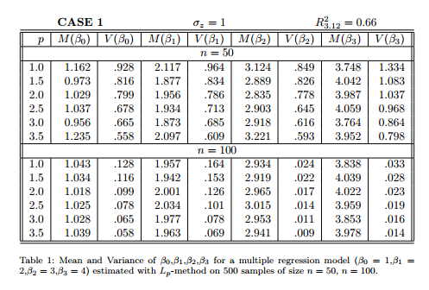

Slide 39
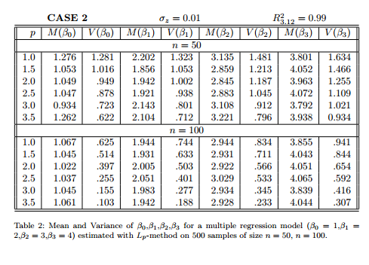

Slide 40
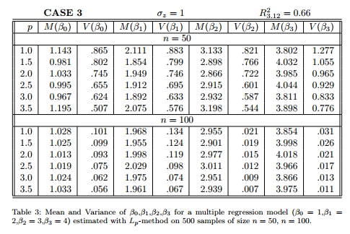

Slide 41
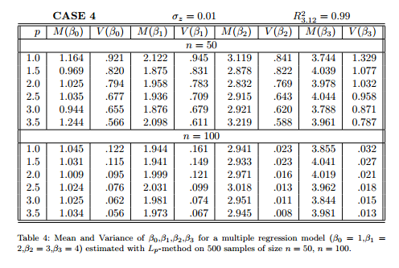

Slide 42
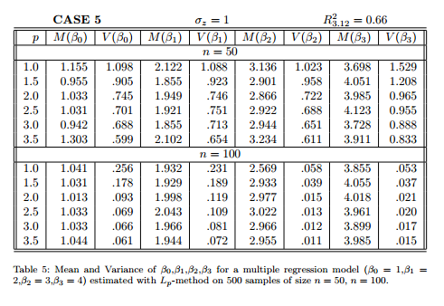

Slide 43
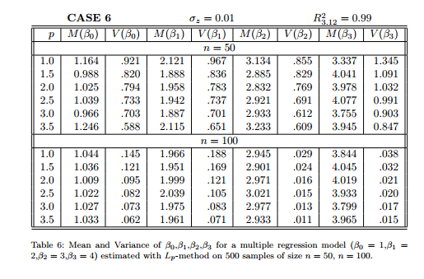

Slide 44
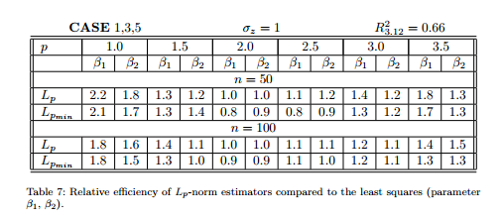
Looking at the simulation results we note that the improvement using Lp estimators instead of least squares is more evident in the case σz = 1 R32.12 = 0, 66 (medium multicollinearity) than in the case σz = 0, 01 R32.12 = 0, 99 (strong multicollinearity).

Slide 45
That is due to the characteristics of Lp methods that are adaptive procedures related to the erratic component of the model and not related to the deterministic one.
Finally, the simulation studies show how our algorithm (Lp min ) achieves more efficient estimates for the regression parameters when compared with the least squares procedure.
In particular, using the Lp and the Lp min method , a better performance, in terms of the variances of the parameter estimates, is always obtained in the case of nonnormal symmetric distributions compared the least squares situation also considering a model with collinear regressors.

Slide 46
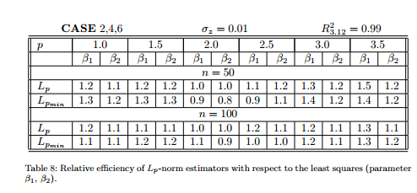
References AGRO’ G. (1995): ”Maximum likelihood estimation for the exponential power function parameters”. Comm. Statist - Simula. Computa.,24, pp. 523,536. AGRO’ G. (1999): ”Ortogonalita dei parametri e verosimiglianza profilo condizionata: il caso della distribuzione normale di ordine p”. Annali della Facolta di Economia di Palermo, Area Statistico-Matematica, 9-18.

Slide 47
BELSLEY; KUH; and WELSCH (1980). ”Regression diagnostics: Identifying influential data and sources of collinearity”. New York: John Wiley and Sons. BRING, J. (1996). A geometric approach to compare variables in a regression model. The American Statistician, 50, 57-62. CASSEL, C.; WESTLUND, A. H.; & HACKL, P. (1999): ”Robustness of partial least-squares method for estimating latent variable quality structures”. Journal of Applied Statistics, 26, 435-448. CHIODI M. (1986): ”Procedures for Generating Pseudo-Random Numbers from a Normal Distribution of Order p” Riv. Stat. Applicata, 19, pp. 7-26. COX D.R., HINKLEY D.V. (1968): ”A note on the Efficiency of Least Squares Estimates”. Journal of Royal Statistical Society, B; 30, 841. COX D.R., REID N. (1987): ”Parameter orthogonality and approximate conditional inference”. Journal of the Royal Statistical Society, B; 49, 1-39.
EKBLOM and HENRIKSSON S. (1969) ” Lp Criteria for the Estimation of Location Parameters” SIAM J. Appl. Math. 17, pp. 1130-1141. ELLIS T.M.R. (1985), ”Programmazione strutturata in Fortran 77” ed. Zanichelli.

Slide 48
EVERITT B. and HAND D. (1987): ”The Statistical Consultant in Action”, New York: Cambridge University Press. FLETCHER R. and REEVES C.M. (1964): ”Function minimization by coniugate gradients” Comput. J., 7, pp. 149-154.
FORSYTHE A.B (1972), Robust Estimation of Straight Line Regression Co efficients by Minimizing pth Power Deviations” Technometrics, 14, pp. 159-166. GIACALONE M. (1996) Parameter Evaluation of an Exponential Power Function by Simulation Study. Shorts Communications and Posters, Comp- stat 96, Barcelona, Spain. GIACALONE M. (1997): ” Lp-norm estimators for nonlinear regression models” Student, vol 2, pp 119-130. GONIN R. and MONEY A.H. (1987): ”A Review of Computational Methods for Solving the Nonlinear L1 Norm Estimation Problem”. S.D.A.B. on the L1 Norm and Related Methods. Dodge ed al., North Holland. GONIN R. and MONEY A.H. (1989) ”Nonlinear Lp-Norm Estimation” Marcel Dekker Inc. New York - Basel.

Slide 49
HARTER H.L. (1977): ”The nonuniqueness of absolute values regression”. Commun. Statist. Simula. Computa. A6, pp. 829-838. KENDALL M.C. and STUART A. (1966): ”The Advanced Theory of Statistics” Griffin, London. LEAHY , K. (2001). Multicollinearity: When the solution is the problem. In Olivia Parr Rud (Ed.) Data Mining Cookbook (pp. 106 - 108). John Wiley & Sons, Inc. LUNETTA G. (1963): ”Di una Generalizzazione dello Schema della Curva Normale” Ann. Facolt Econ. Comm. Palermo, 17, pp. 237-244. LUNETTA G. (1966): ”Di Alcune Distribuzioni Deducibili da una Generalizzazione dello Schema della Curva Normale”. Ann. Facolt Econ. Comm. Palermo, 20, pp. 117-143. MINEO A. (1978), ”Prontuari delle Probabilit Integrali Delle Curve Normali di Ordine r” Edigraphica Sud Europa Palermo. MINEO A. (1989): ”The Norm-p Estimation of Location, Scale and Simple Linear Regression Parameters”. Lectures Notes in Statistics-Statistical Modelling Trento Pringer-Verlag, pp. 222-223.

Slide 50
MINEO A.M. (1994): ”Un nuovo meto do di stima di p p er una corretta valutazione dei param etri di intensit e di scala di una curva normale di ordine p”. Atti della XXXVI I Riunione Scientifica della SIS, vol.2, San Remo pp. 147-154. MONEY A.H. et al. (1982): ”The Linear Regression Model: Lp-Norm Estimation and the Choice of p”. Commun. Statist. - Simula. Computa, 11, pp. 89-109. MORRIS, J.D. (1982): ”Ridge regression and some alternative weighting techniques: A comment on Darlington.” Psychological Bulletin, 91, 203-210. NYQUIST H. (1983), ”The Optimal Lp-Norm Estimator in Linear Regression Models”, Comm. Statist.-Theor Meth., 12, pp. 2511-2524. PAGEL, M.D. & LUNNEBERG, C.E. (1985): ”Empirical evaluation of ridge regression”. Psychological Bulletin, 97,342-355. SAVILLE, D. & WOOD, G. R. (1991). Statistical methods: The geometric approach. New York: Springer-Verlag SPOSITO V.A. (1983): ”On Unbiased Lp Regression”. J.A.S.A., 77. SUBBOTIN M. (1923): ”On the Law of Frequency of Error”. Mathematicheskii Sbornik. VIANELLI S. (1963): ”La Misura della Variabilit Condizionata in uno Schema Generale delle Curve Normali di Frequenza”. Statistica, XXIII n 4.

Slide 51
Thank you!

